Slide 1




Cruiser SE Series
Outdoor PT Camera
By Imou Team

Slide 2
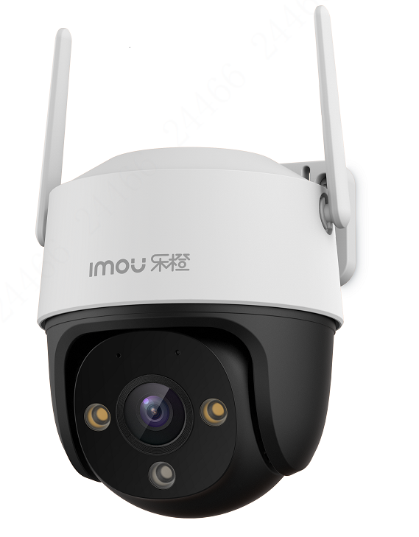

01
Introduction
02
Key Features & Benefits
03
Application
04
Ordering Information
Introduction

Slide 3
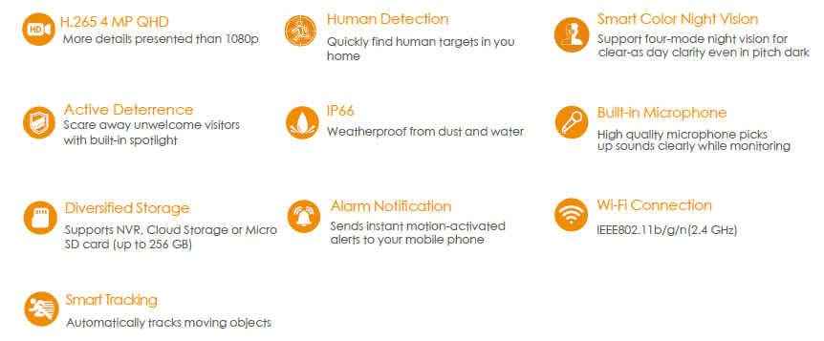



Introduction
Cruiser SE/Cruiser SE 4MP
Cruiser SE delivers 1080P/4MP live monitoring with a choice of 3.6 mm / 6 mm lens option, With 4MP QHD live monitoring and 0~355° pan & 0~90°tilt features, Cruiser SE 4MP ensures every corner of your home completely covered. It supports four night vision modes for clear-as day clarity even in pitch dark. With IP66 certified, the camera can be used outdoors under different weather conditions. With built-in spotlight , Cruiser SE 4MP actively keeps unwelcome visitors away from what you care about.
Notes:
能否套套子

Slide 4
01
Introduction
02
Key Features & Benefits
03
Application
04
Ordering Information
Key Features
& Benefits

Slide 5
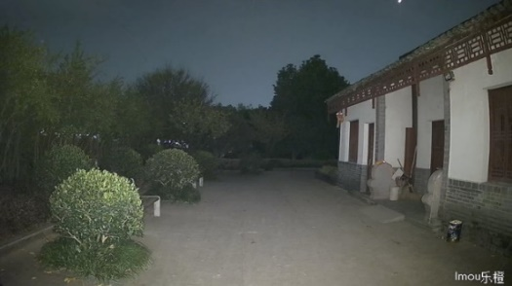
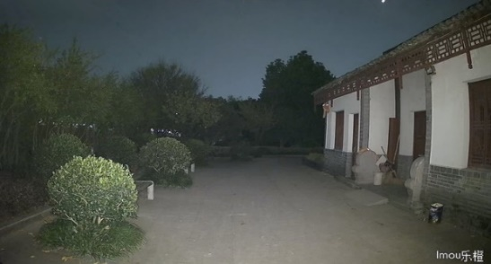
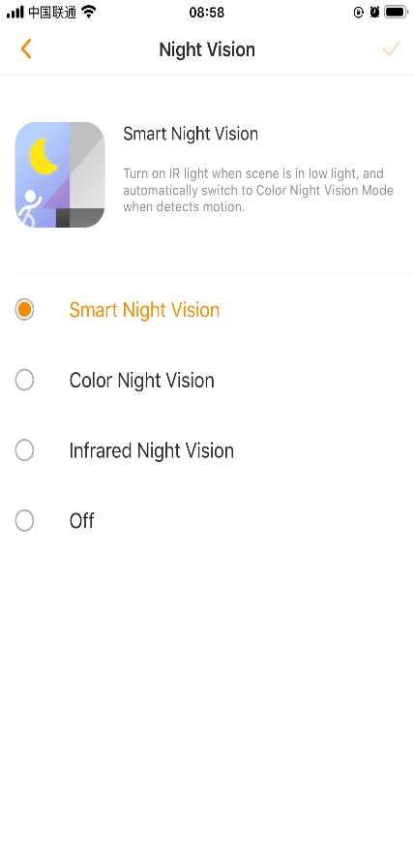


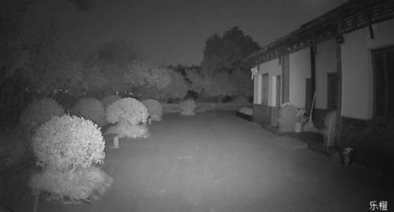

Benefits &
Key Features
Smart Color Night Vision
Four smart night vision modes provide clear full color or black-and-white pictures even in complete darkness.
Smart Mode
Color Mode
If you switch to the Smart Mode, you can enjoy black and white night vision. The spotlights automatically turn on upon detection of suspicious motion, which shows you vivid full-color image when something happens.
Thanks to the two built-in spotlights, your night vision is now lit up and in full-color. Color Mode also offers outdoor lighting for your home.
Infrared Mode
Off Mode
Advanced IR algorithms provide clear black-and-white pictures even in darkness.
Turn off all night vision modes
Infrared and spotlights all turned off

Slide 6
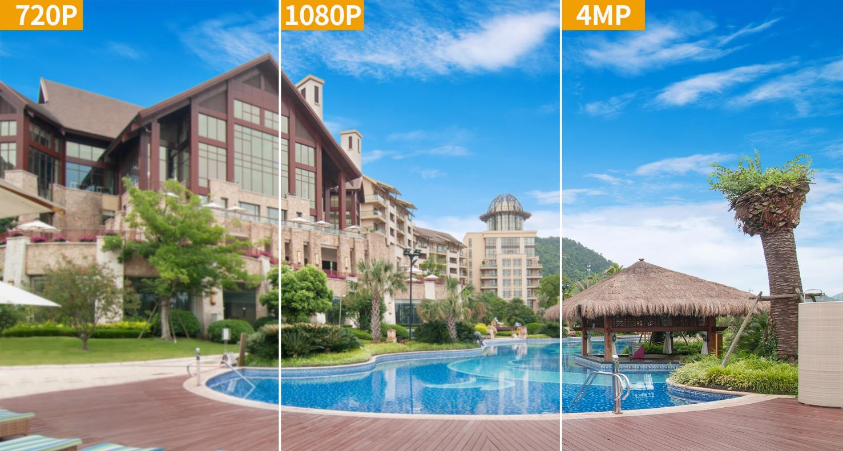

Benefits &
Key Features
  4MP QHD Video
High quality sensors present crystal clear videos and recordings.
Cruiser SE support 1080P and Cruiser SE 4MP support 4MP

Slide 7
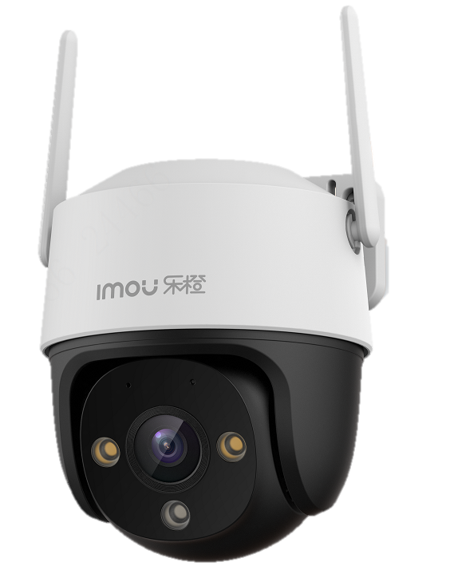

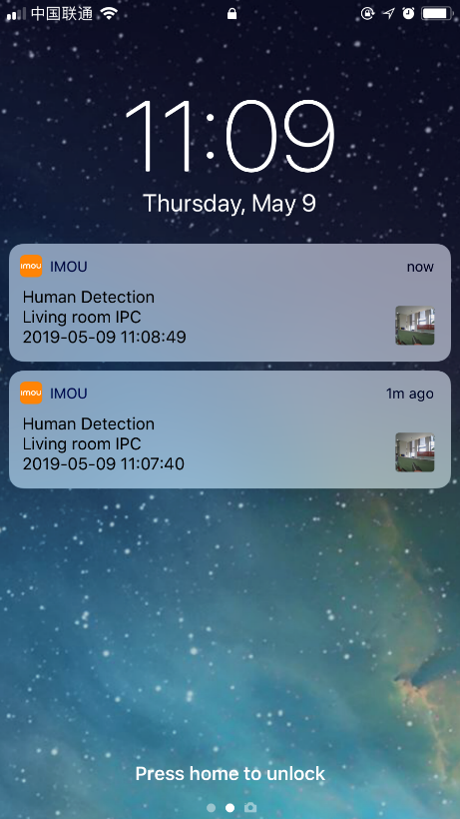

Benefits &
Key Features
Human Detection
Powerful image processing technology quickly finds human targets in images and immediately sends a notification to your smartphone, allowing you to monitor what matters without receiving annoying false alerts

Slide 8
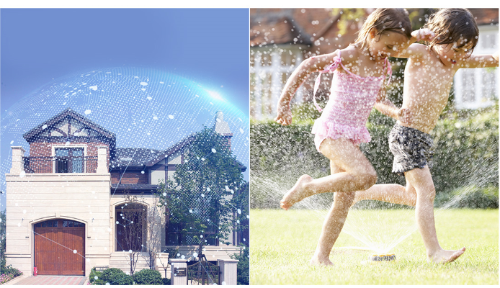
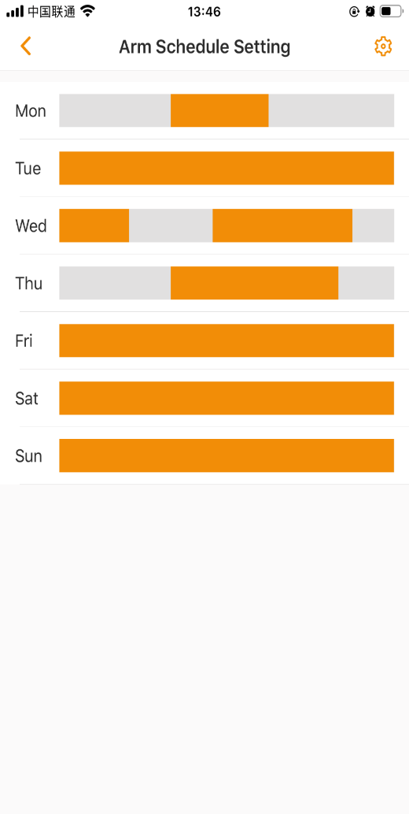
Benefits &
Key Features
Arm Schedule
Supports arm schedule setting, you can choose anytime you want arm or not.

Slide 9
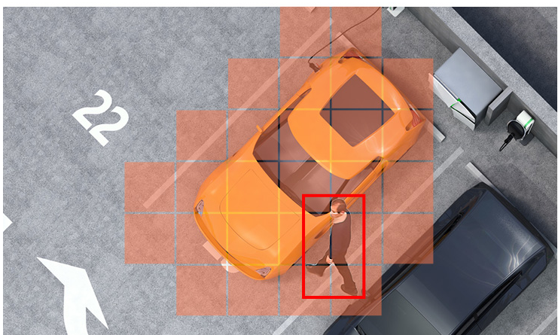
Benefits &
Key Features
Detection Region
Tap and select grid to set motion detection area. No alarm will be triggered when motion is detected in the non-motion detection area.

Slide 10
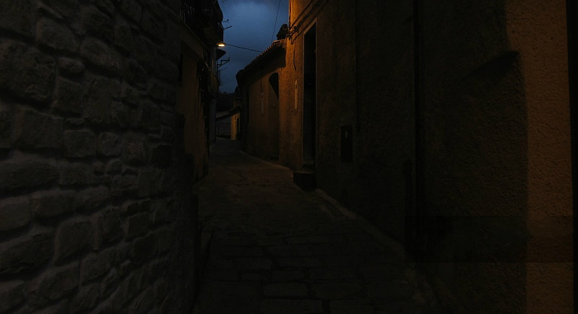



Benefits &
Key Features
Active Deterrence
When the camera detects intrusion, with built-in spotlight turns on, Cruiser actively keeps unwelcome visitors away from what you care before you notice them.
Spotlight

Slide 11
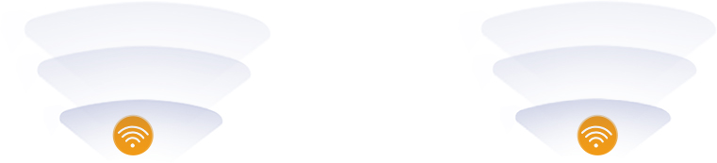
Benefits &
Key Features
Excellent Wi-Fi Performance
2.4GHz Wi-Fi with external antenna ensures stable video streaming even at long ranges
*2 external Wi-Fi antenna for better Wi-Fi performance.

Slide 12
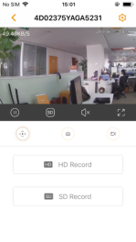


Benefits &
Key Features
  Built-in Wi-Fi Hotspot
Supports soft AP mode, so you can stream the video, play recording even when there is no Internet connection.
Step1: Press twice the camera’s reset button, it’ll enter soft AP mode
Step2: Connect smartphone to camera’s Wi-Fi hotspot signal, the Wi-Fi name is “DAP-XXXX”, password is the Safety Code on device label.
Step3: On Imou Life App, go to “me”→ ”Tool”→ ”Lan Live”, and follow the guide on the App.

Slide 13

Benefits &
Key Features
Built-in Microphone
High quality microphone picks up sounds clearly while monitoring.
*The real distance relates to actual situations

Slide 14
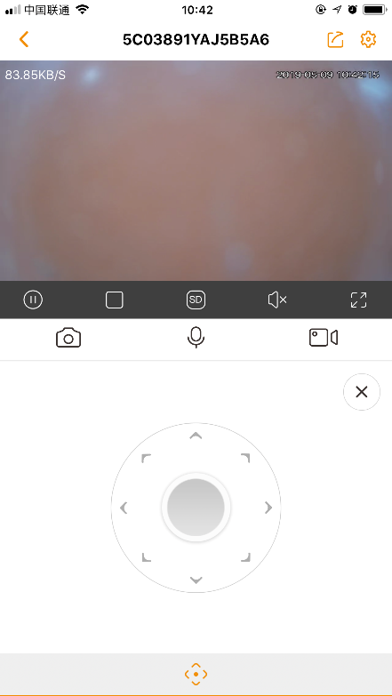
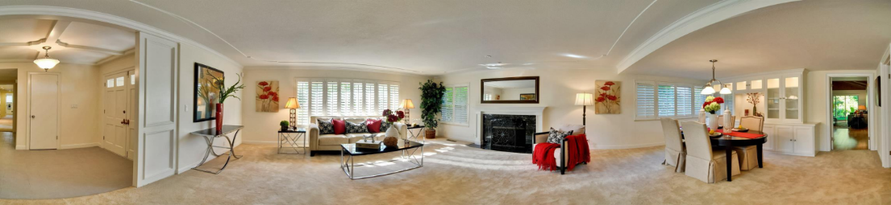

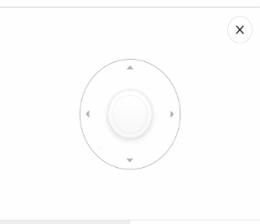
Benefits &
Key Features
0~355° Pan & 0°~ 90° Tilt
Rotate the camera to view every corner of your home, and full range ensures no blind spots.
0° ~ 90°Tilt
0 ~ 355°Pan

Slide 15

Benefits &
Key Features
Weatherproof
Cruiser SE is IP66 certified for use in extreme outdoor conditions.

Slide 16
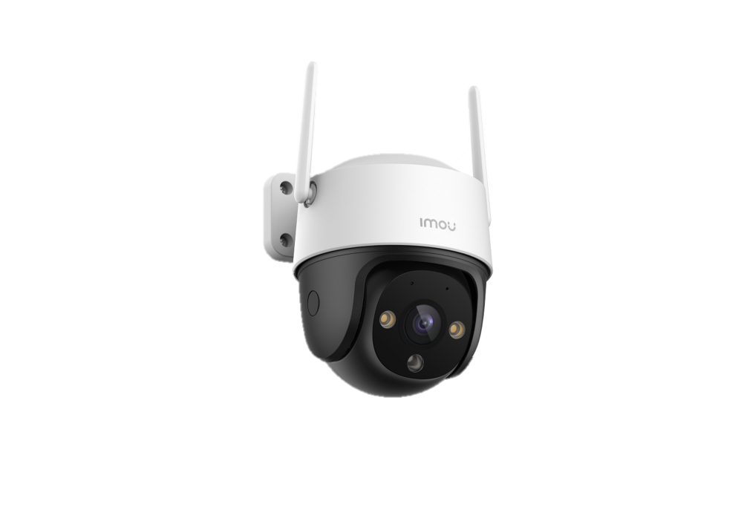
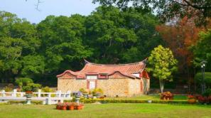

Benefits &
Key Features
Multiple Lens Options
Different focal length for different scenarios
3.6mm
6mm
3.6mm
Field of view(H)
6mm
Target: 2m(6.5ft)，Install Height: 3m(9.8ft)
Cruiser SE 4MP
3.6mm: discover the target at 78m, field of view is 78°.
6mm: discover the target at 109m, field of view is 49°
Cruiser SE
3.6mm: discover the target at 55.2m, field of view is 86°.
6mm: discover the target at 83m, field of view is 51°
* The distance is for reference only, please choose the right lens according to real scenario.

Slide 17



Benefits &
Key Features
Diversified Storage
Video is easily stored and accessed through SD Card, NVR, or Cloud storage.
Cloud Storage
3-DAY Playback
PER CAMERA
7-DAY Playback
PER CAMERA
30-DAY Playback
PER CAMERA
A free 30-day trial is available for every new registered Imou device
Cloud video storage is based on alarms, let you never miss the moments
Local Storage
Cruiser SE supports 7*24 continuous recording in Micro SD card (up to 256GB)

Slide 18
01
Introduction
02
Key Features & Benefits
03
Application
04
Ordering Information
Key Features
& Benefits

Slide 19



Application
Multiple Scenarios
Warehouse
Store
Villa

Slide 20
01
Introduction
02
Key Features & Benefits
03
Application
04
Ordering Information
Key Features
& Benefits

Slide 21
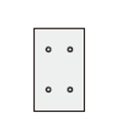


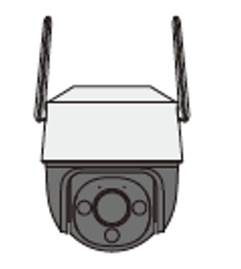
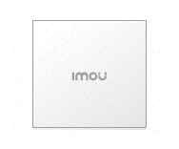
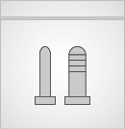
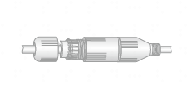
Ordering Information
What’s in the box
Mounting Template x1
Mounting Bracket x1
Power Adapter x 1
Camera x1
QSG x1
Screw Package x1
Waterproof Connector x1

Slide 22
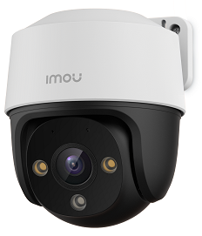
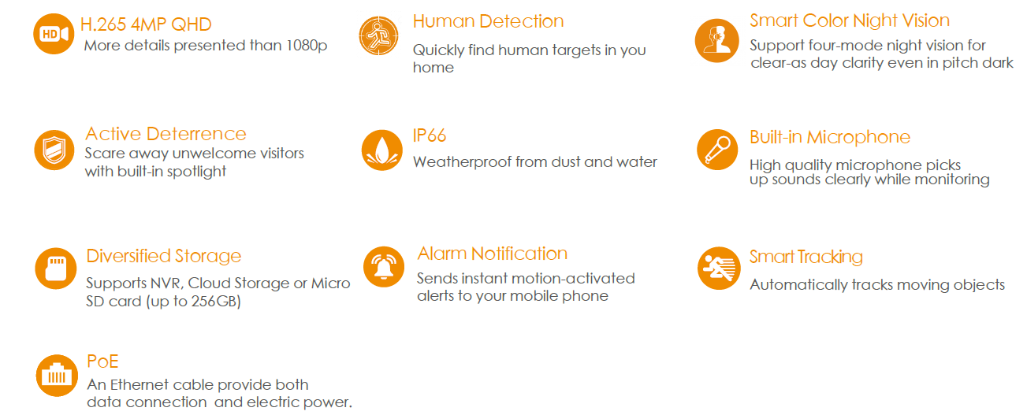
Introduction
S21FA/ S41FA
1080P/4MP P&T PoE Camera
S21FA/S41FA delivers 1080P/4MP live monitoring with a choice of 3.6mm/6mm lens option, With 4MP QHD live monitoring and 0~355° pan & 0~90°tilt features, S21FA/S41FA ensures every corner of your home completely covered. It supports four night vision modes for clear-as day clarity even in pitch dark. With IP66 certified, the camera can be used outdoors under different weather conditions. With built-in spotlight , S21FA/S41FA actively keeps unwelcome visitors away from what you care about.
Notes:
能否套套子

Slide 23
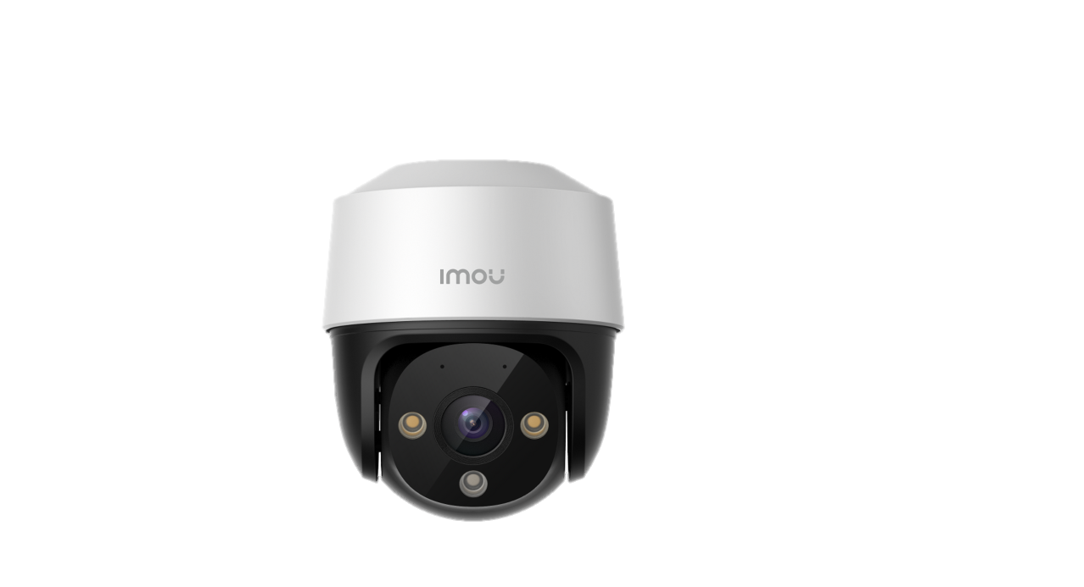


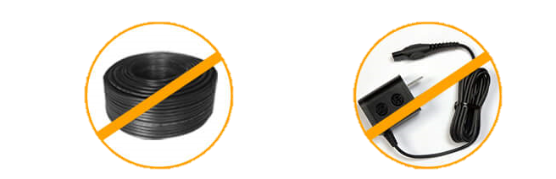
Benefits &
Key Features
Power over Ethernet
The Power-over-Ethernet (PoE) support allows for this camera to be installed by means of just an Ethernet cable to provide both data connection and electric power.

Slide 24
Ordering Information
Product Model---Wi-Fi
Item Number
Nickname
External Model
Internal Model
Product Type
1.0.03.04.11241 | Cruiser SE | IPC-S21FP | IPC-S21FP-0360B-imou | Imou
1.0.03.04.11242 | Cruiser SE | IPC-S21FN | IPC-S21FN-0360B-imou | Imou
1.0.03.04.11226 | Cruiser SE | IPC-S21FP | IPC-S21FP-0600B-imou | Imou
1.0.03.04.11243 | Cruiser SE | IPC-S12FN | IPC-S21FN-0600B-imou | Imou
1.0.03.04.11281 | Cruiser SE 4MP | IPC-S41FP | IPC-S41FP-0360B-imou | Imou
1.0.03.04.11283 | Cruiser SE 4MP | IPC-S41FN | IPC-S41FN-0360B-imou | Imou
1.0.03.04.11282 | Cruiser SE 4MP | IPC-S41FP | IPC-S41FP-0600B-imou | Imou
1.0.03.04.11284 | Cruiser SE 4MP | IPC-S41FN | IPC-S41FN-0600B-imou | Imou

Slide 25
Ordering Information
Product Model---PoE
Item Number
Nickname
External Model
Internal Model
Product Type
1.0.03.04.11301 | S21FA | IPC-S21FAP | IPC-S21FAP-0360B-imou | Imou
1.0.03.04.11303 | S21FA | IPC-S21FAN | IPC-S21FAN-0360B-imou | Imou
1.0.03.04.11302 | S21FA | IPC-S21FAP | IPC-S21FAP-0600B-imou | Imou
1.0.03.04.11304 | S21FA | IPC-S21FAN | IPC-S21FAN-0600B-imou | Imou
1.0.03.04.11260 | S41FA | IPC-S41FAP | IPC-S41FAP-0360B-imou | Imou
1.0.03.04.11262 | S41FA | IPC-S41FAN | IPC-S41FAN-0360B-imou | Imou
1.0.03.04.11261 | S41FA | IPC-S41FAP | IPC-S41FAP-0600B-imou | Imou
1.0.03.04.11263 | S41FA | IPC-S41FAN | IPC-S41FAN-0600B-imou | Imou

Slide 26

THANK

